Slide 1

Project Title: Expense Tracker App

Slide 2
Project Description:
The Expense Tracker App is a lightweight desktop application built with Python and Tkinter that helps users record, manage, and visualize their daily expenses. It provides a user-friendly interface for logging expenses, categorizing them, storing data persistently, and analyzing monthly spending through pie chart summaries.
This project is ideal for individuals or small-scale users looking for an offline and portable solution to monitor financial habits and make informed budgeting decisions.

Slide 3
Technologies & Tools Used
Category | Technology / Tool | Purpose
Programming Language | Python | Core language used for the entire application
GUI Framework | Tkinter | Building the desktop graphical user interface
Data Storage | JSON | Storing expense records in structured key-value format
Spreadsheet Support | openpyxl | Writing and updating expenses in Excel format (.xlsx)
Data Visualization | matplotlib | Creating pie charts for monthly expense summaries
File Handling | os, datetime, json | Managing files, dates, and reading/writing JSON data
Dialog Utilities | tkinter.messagebox, simpledialog | User alerts and input prompts
Excel File Format | Microsoft Excel (.xlsx) | Exporting data for reporting, backup, and offline access
Development Platform | Local Desktop Environment | Runs locally on Windows/Linux/Mac without server setup

Slide 4


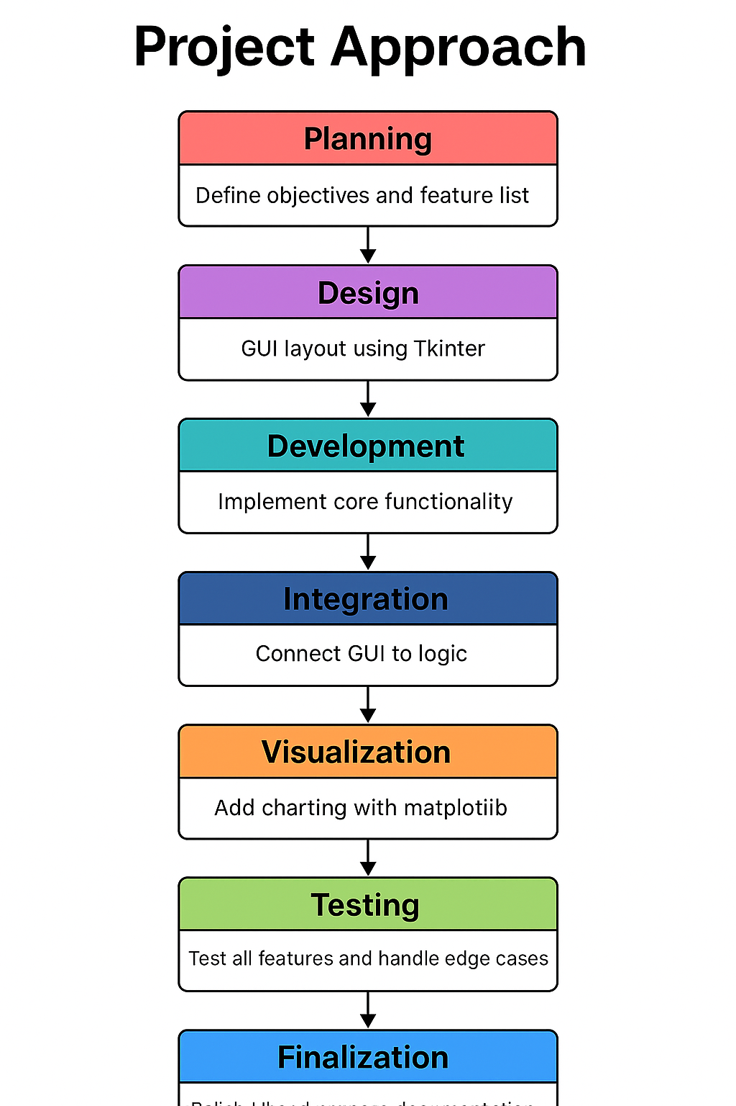

Project Approach Summary :
The Expense Tracker App was developed using a structured approach, starting with planning the core features like adding, storing, viewing, and summarizing expenses. The GUI was designed using Tkinter for simplicity and ease of use. Python functions were implemented to handle data logic, including validation, JSON storage, and Excel export via openpyxl.
The application was then integrated with matplotlib to visualize monthly expense summaries through pie charts. Rigorous testing was done to ensure functionality, handle user errors, and validate inputs. Finally, UI enhancements, exception handling, and documentation were added to ensure a smooth user experience and maintainability.

Slide 5
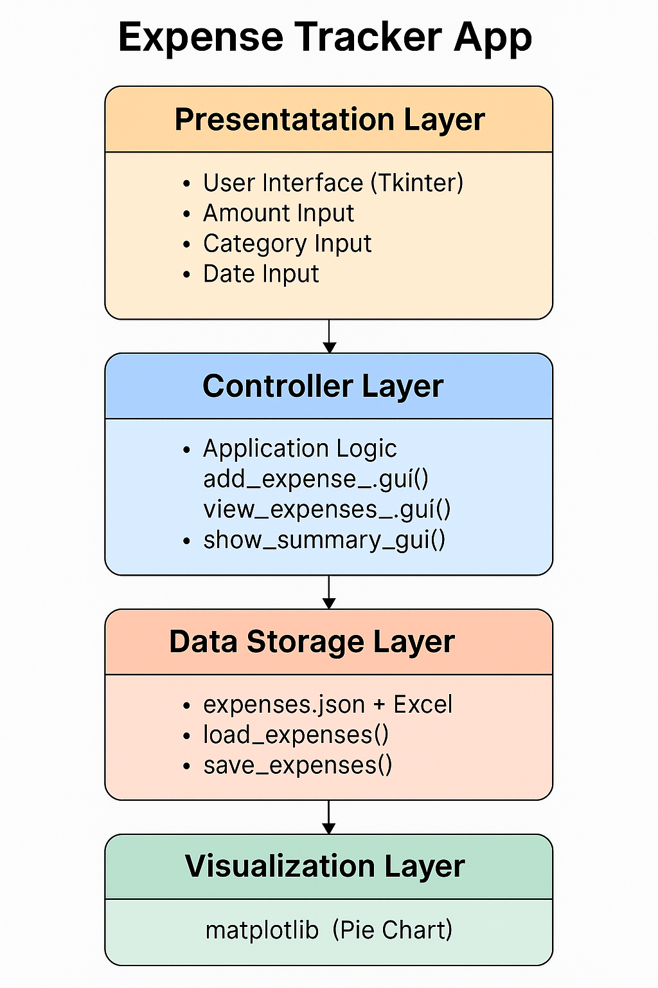

Slide 6
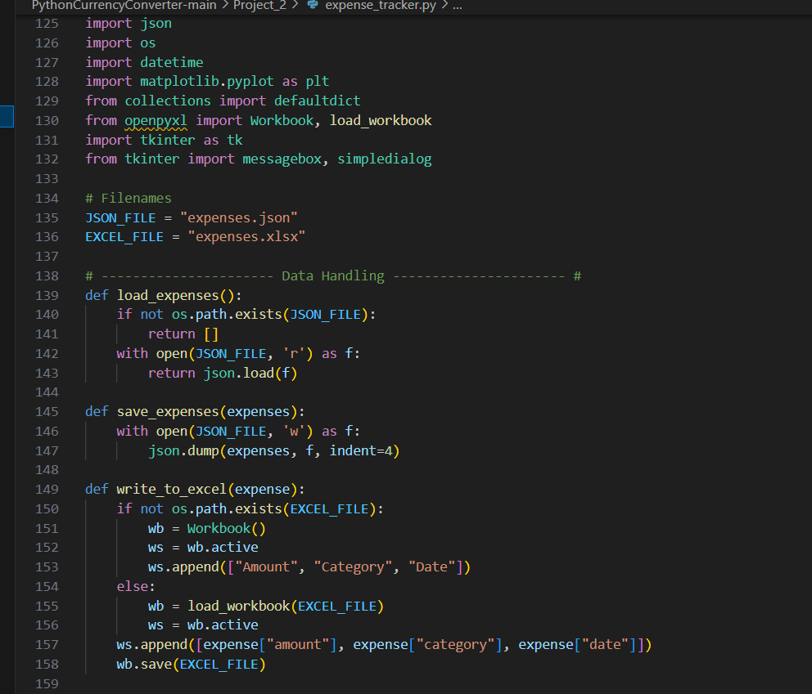
CODES:

Slide 7
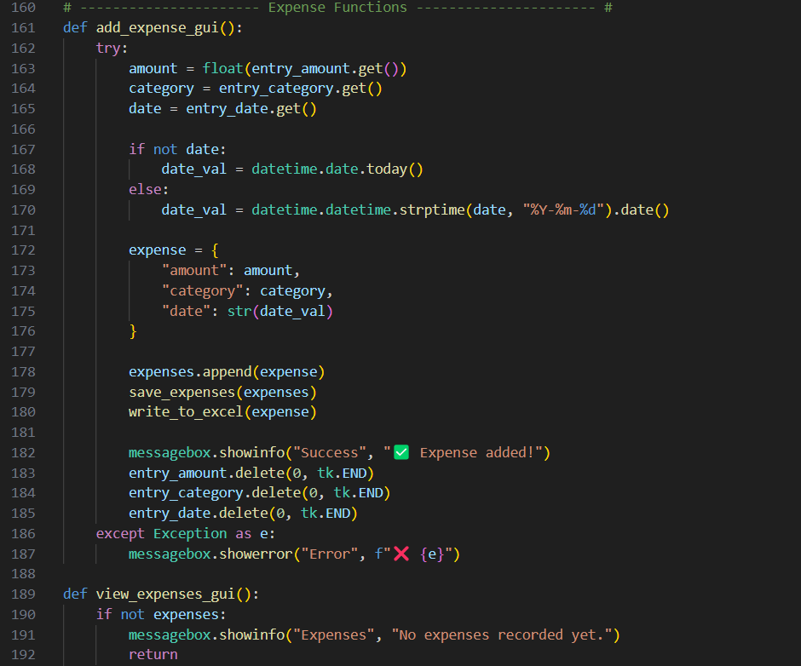

Slide 8
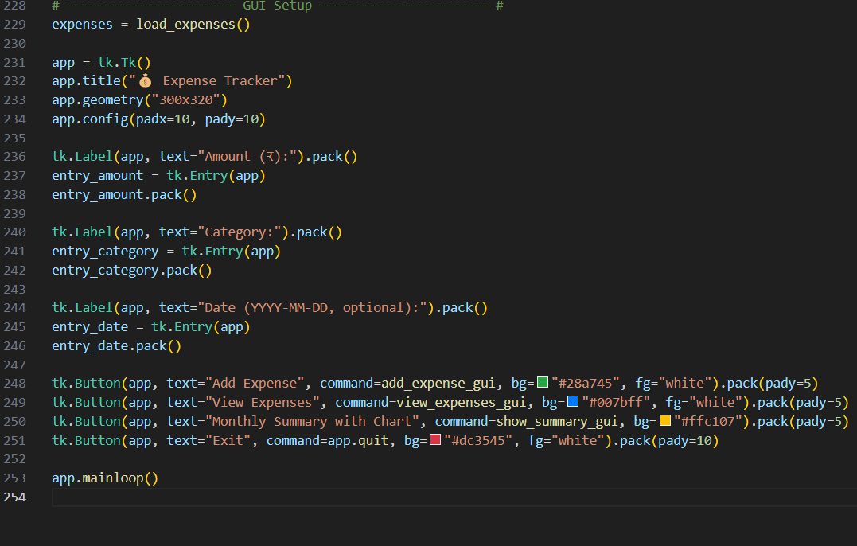

Slide 9
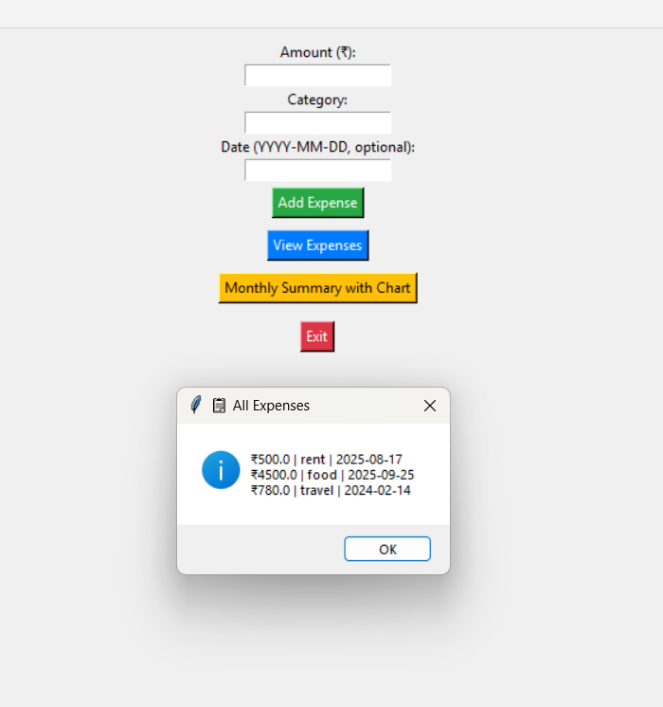
Output:

Slide 10
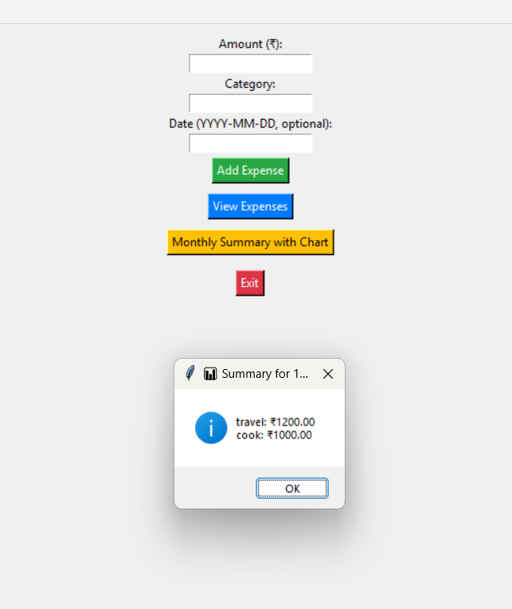

Slide 11
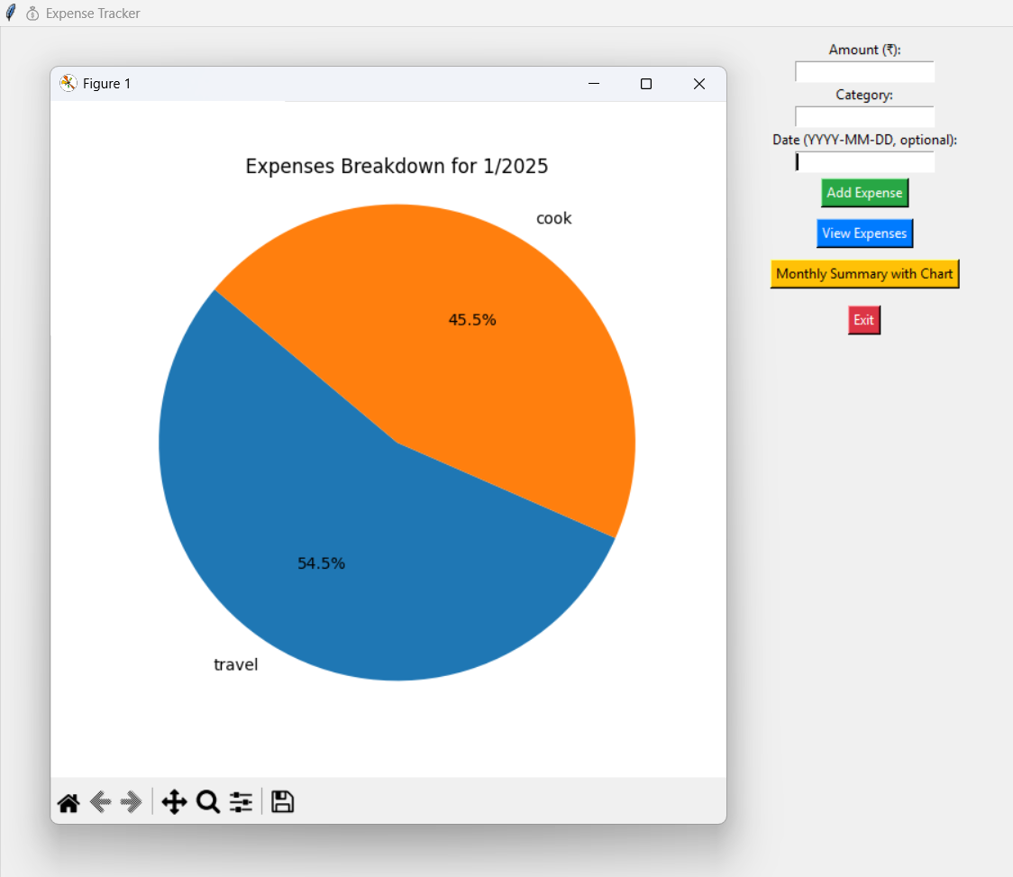
Output withVisualization

Slide 12

Project Title : Expense Tracker App
SUBMITTED BY: JATIN KUMAR
SUBMITTED TO TAMIZHAN SKILLS

